Slide 1
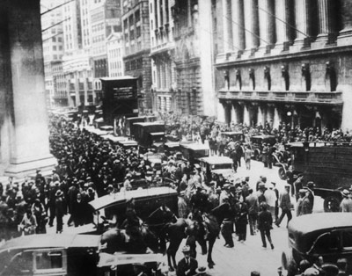
Crash !
Chapter 25, Section 1

Slide 2
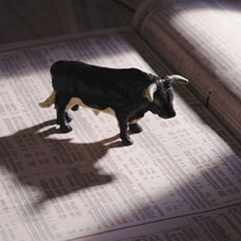
Before the Crash
Most of 1920’s the stock market was a bull market
Rising stocks
Many people bought stocks
If you couldn’t pay for stocks…
Buying on margin
Buy stocks with borrowed money

Slide 3
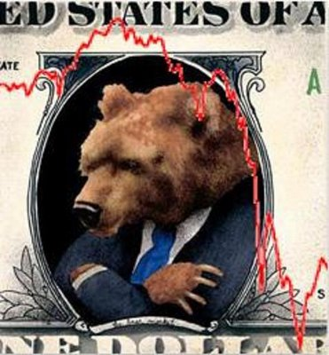
Sounds great…but what if stock market is bear market
Declining stock prices

Slide 4
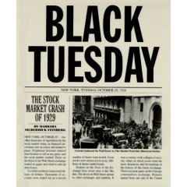
Crash
Prices peaked in summer of 1929
People rushed to sell
Thursday, October 24 = panic
3 hours = $11 billion lost
Tuesday, October 29th
Black Tuesday
stock market crashed

Slide 5
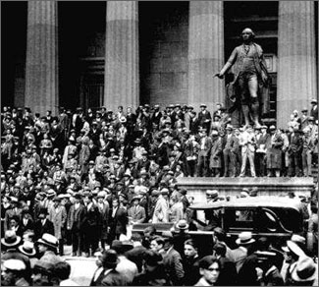
Numbers
September 1929
$87 billion lost
Two months later
$30 billion more lost

Slide 6
Effects
Banking crisis
Banks lost everything, closed
People lost all their savings and businesses
By 1931
2,200 banks closed
By 1929
4 million unemployed Americans

Slide 7
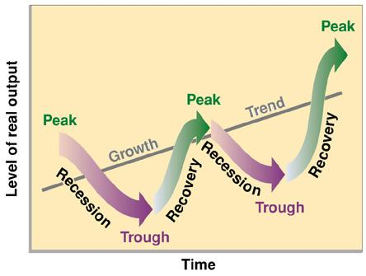
What is going on?
Recession
Business cycle
Up and down pattern

Slide 8
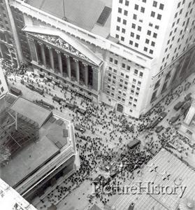
Causes
Money Policy of U.S. government
Overproduction of goods
Uneven distribution of wealth
Declining world trade

Slide 9
Americans were angry at the lack of government response.

Slide 10
President Hoover
Did not believe government should help

Slide 11
What Hoover did do…
Created Reconstruction Finance Corporation
loaned $1.2 billion to financial institutions

Slide 12
Hoovervilles
Homeless vets protested the lack of help from Hoover
groups of tin and cardboard shacks, were built.
These shacks were across the street from the White House

Slide 13
Bonus Army
war veterans built a Hooverville in Washington, D.C., and demanded early payment of a military bonus.

Slide 14
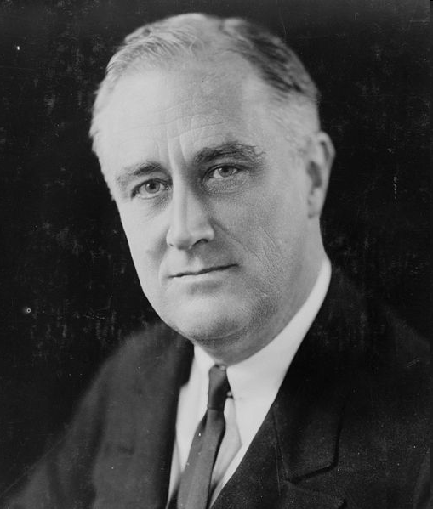
Election of 1932
Hoover did not run for a second term…but knowing that he probably wouldn’t win
Most of the public lost confidence in him
Franklin D. Roosevelt, governor of New York, won in a landslide

